Slide 1
ESP8266-01 GUIDE
OBJECTIVE: PROGRAM ESP8266 MODULE USING AN ARDUINO UNO AND ARDUINO IDE

Slide 2
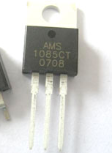
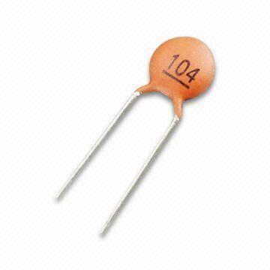

PARTS REQUIRED
ESP8266
ARDUINO UNO
ARDUINO IDE
100OHM RESISTOR
3.3V VOLTAGE REGULATOR(I USED AMS1085CT)
10 MICROFARAD CAPACITOR

Slide 3
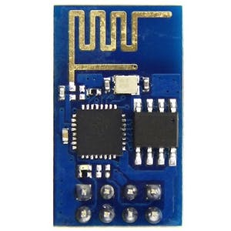
ESP8266 PINS
RX
VCC
GPIO0
RESET
GPIO2
CH_PD
GND
TX

Slide 4
TWO MODE
PROGRAMMING MODE
RUN MODE

Slide 5
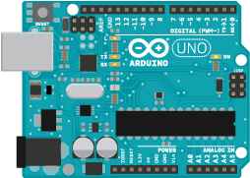
WIRING SCHEMATIC-PROGRAMMING MODE USE THIS MODE WHEN YOU ARE UPLODING THE CODE INTO ESP8266
RX
RX
GPIO0
5V
GPIO2
GND
RESET
VCC
RESET
GND
CH_PD
TX
TX

Slide 6
WIRING SCHEMATIC-RUN MODE USE THIS MODE WHEN YOU ARE RUNNING THE CODE IN ESP8266- SAME AS PROGRAMMING MODE, JUST DISCONNECT GPIO0 TO GND
RX
RX
GPIO0
5V
GPIO2
GND
RESET
VCC
RESET
GND
CH_PD
TX
TX

Slide 7
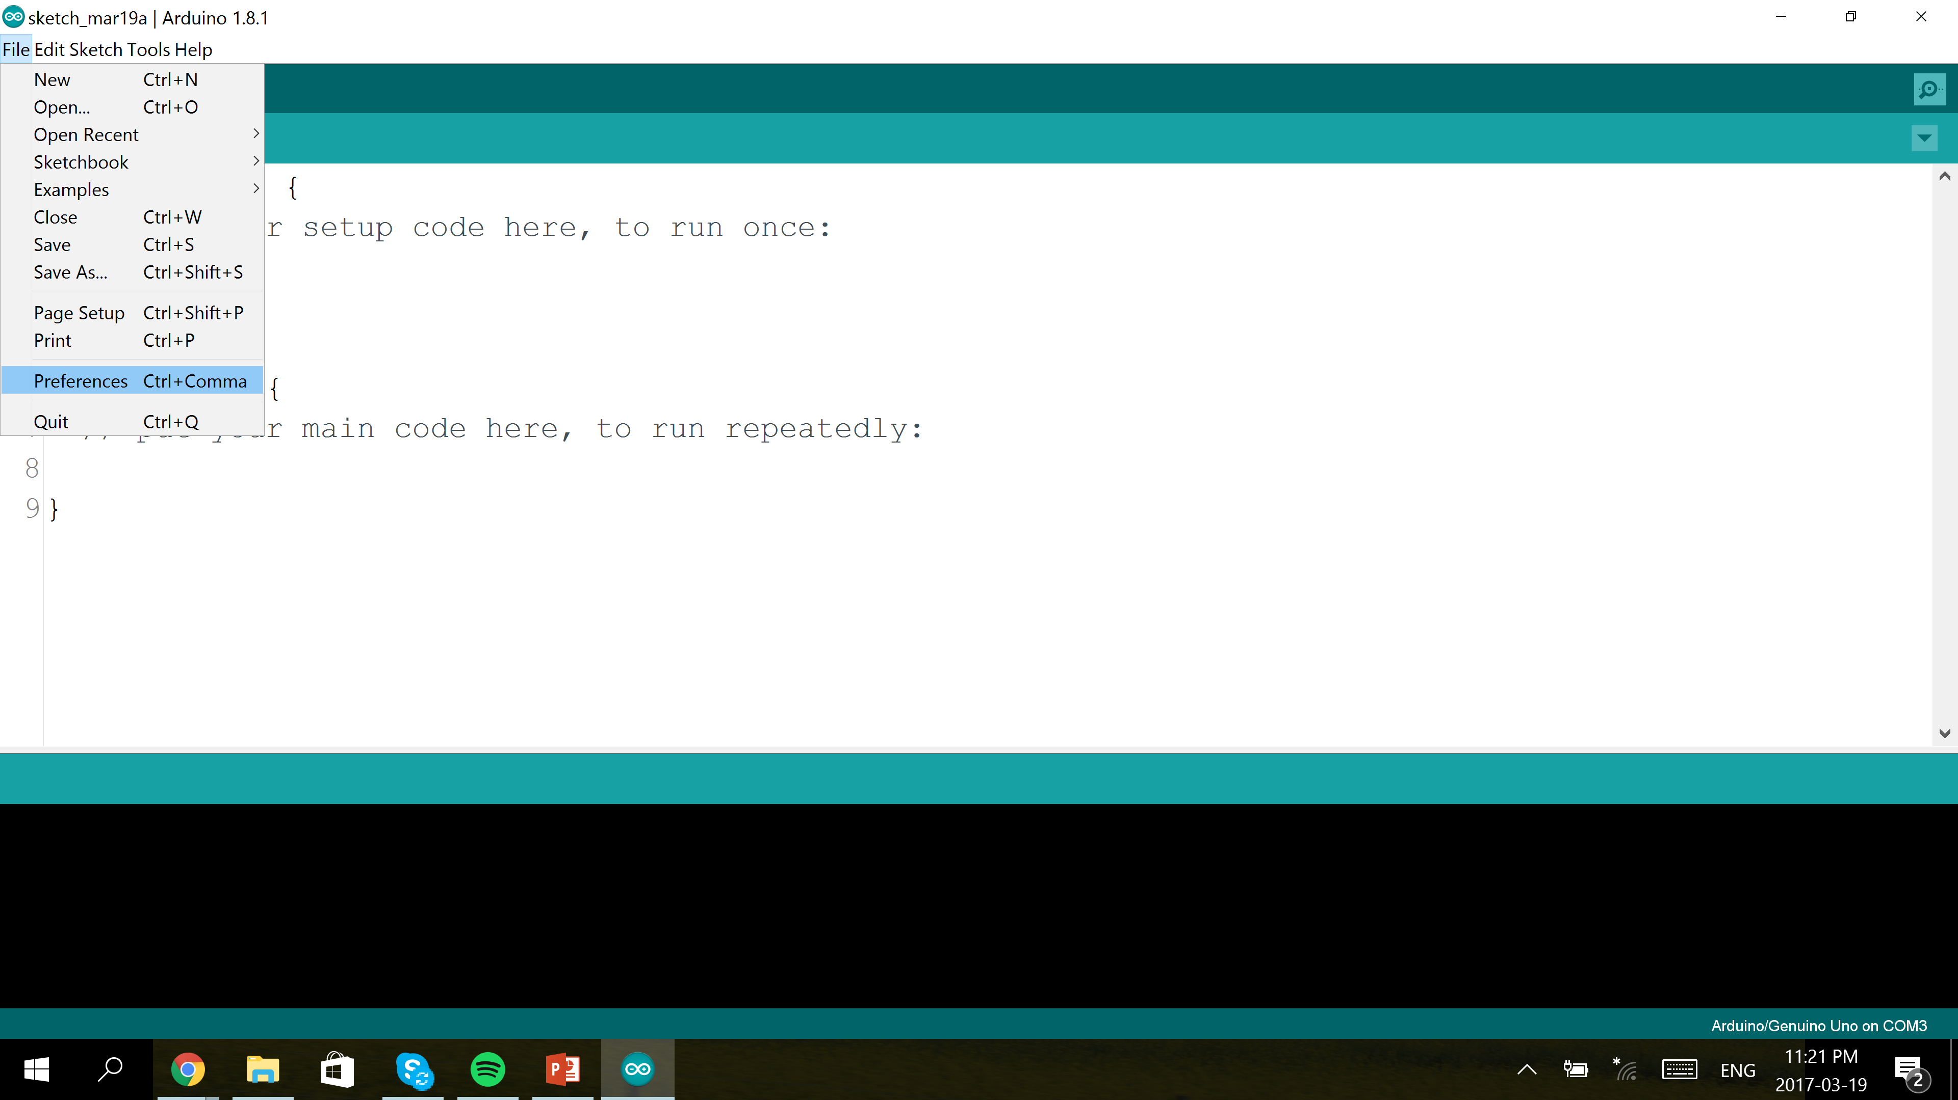
Set up Arduino IDE 1.

Slide 8
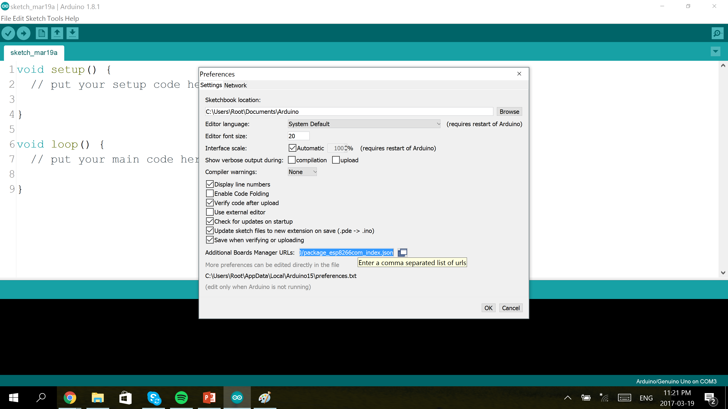
2.Type in: http://arduino.esp8266.com/stable/package_esp8266com_index.json and hit ok

Slide 9
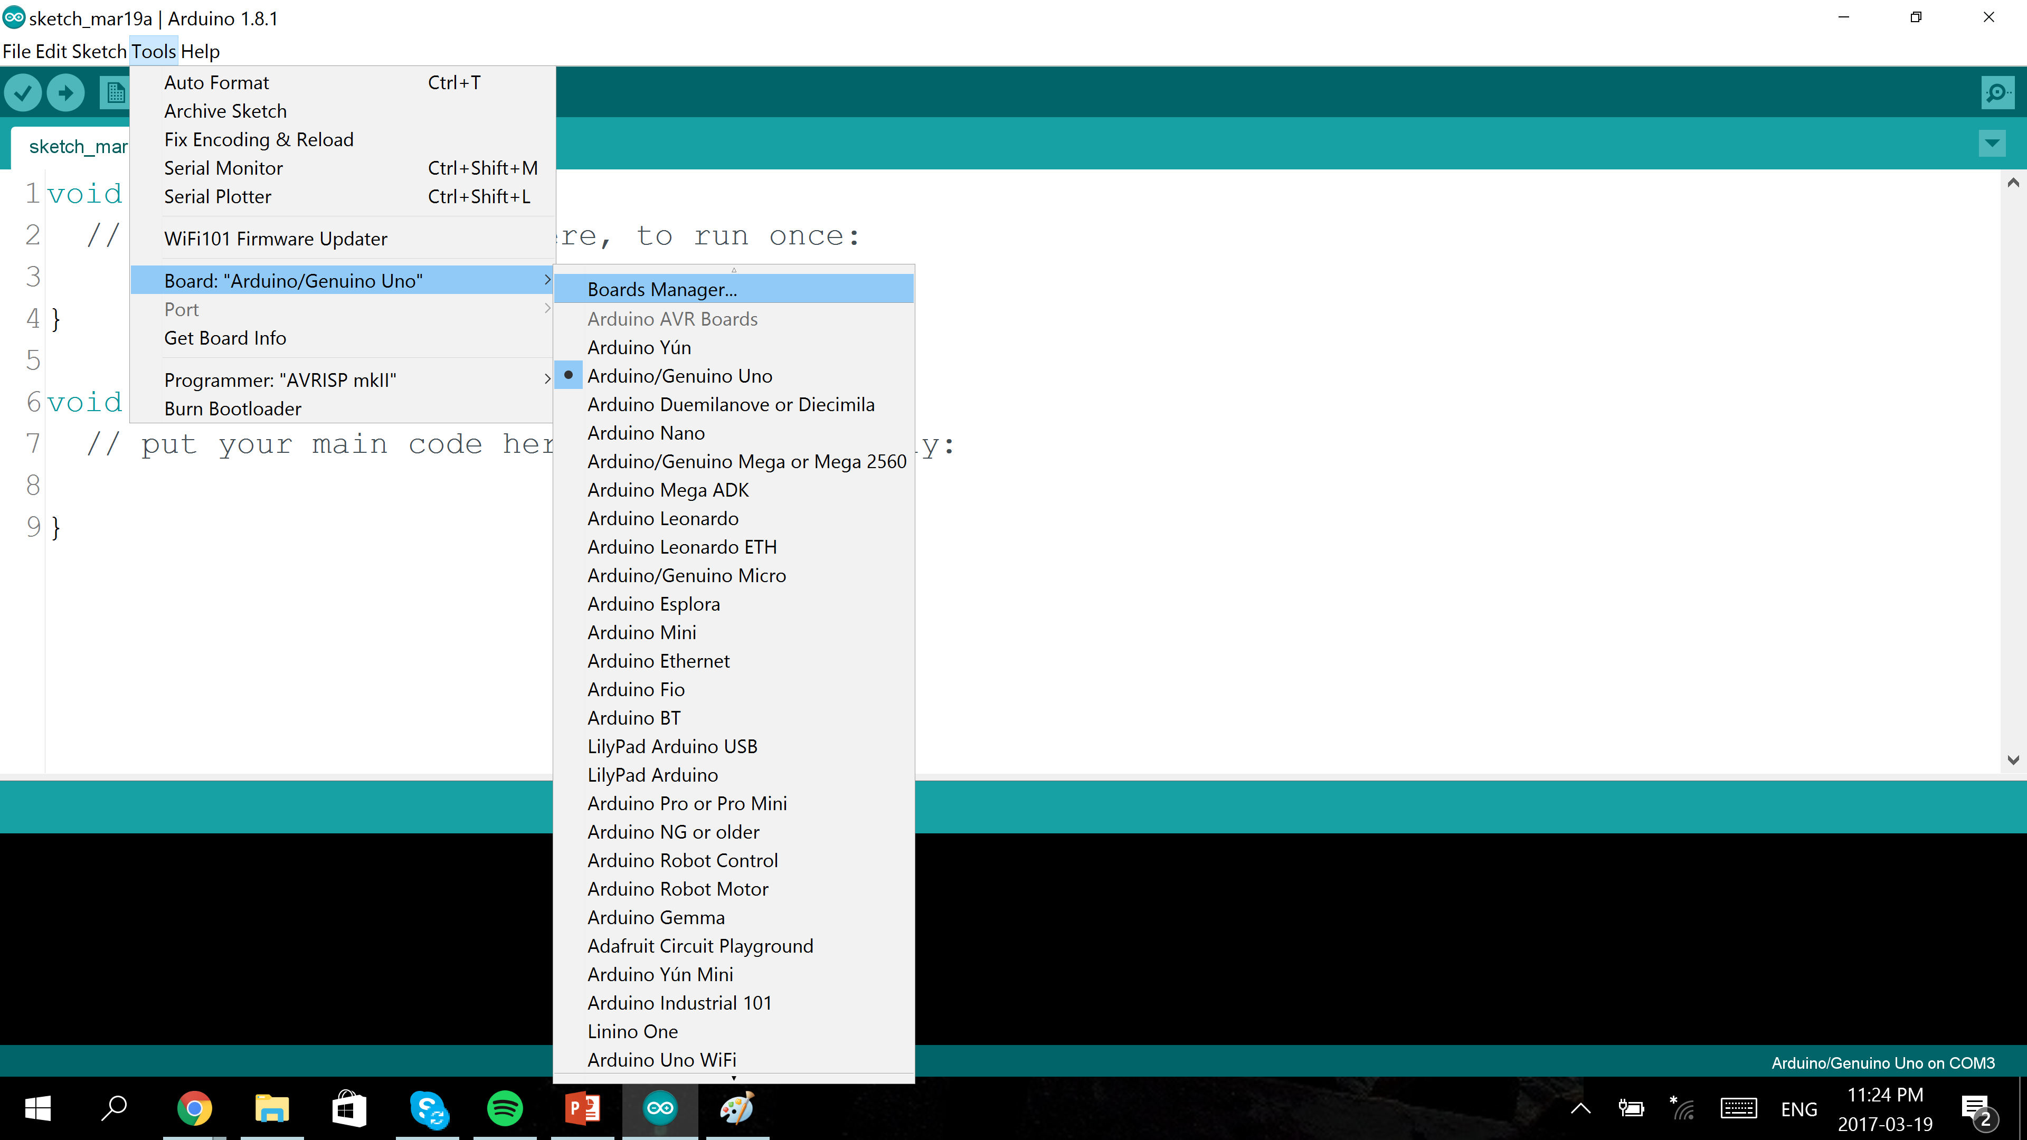
3.

Slide 10
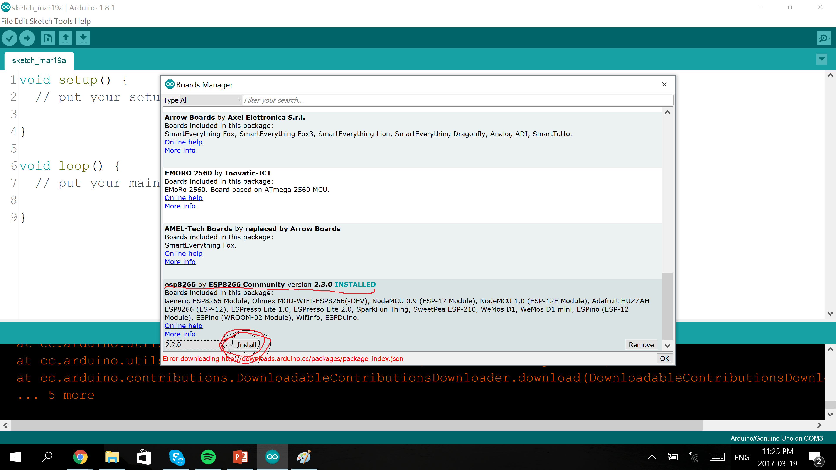
4.Find esp8266 by esp8266 at the bottom and hit install 2.3.0. Restart the IDE once installation finishes

Slide 11
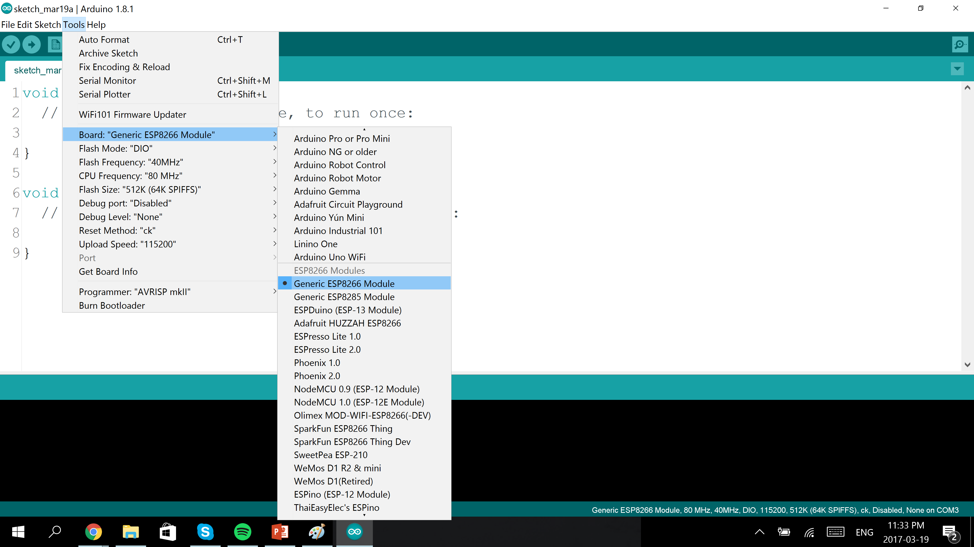
5. After you have restarted the ide, go to tools, board, and select Generic ESP8266 module

Slide 12
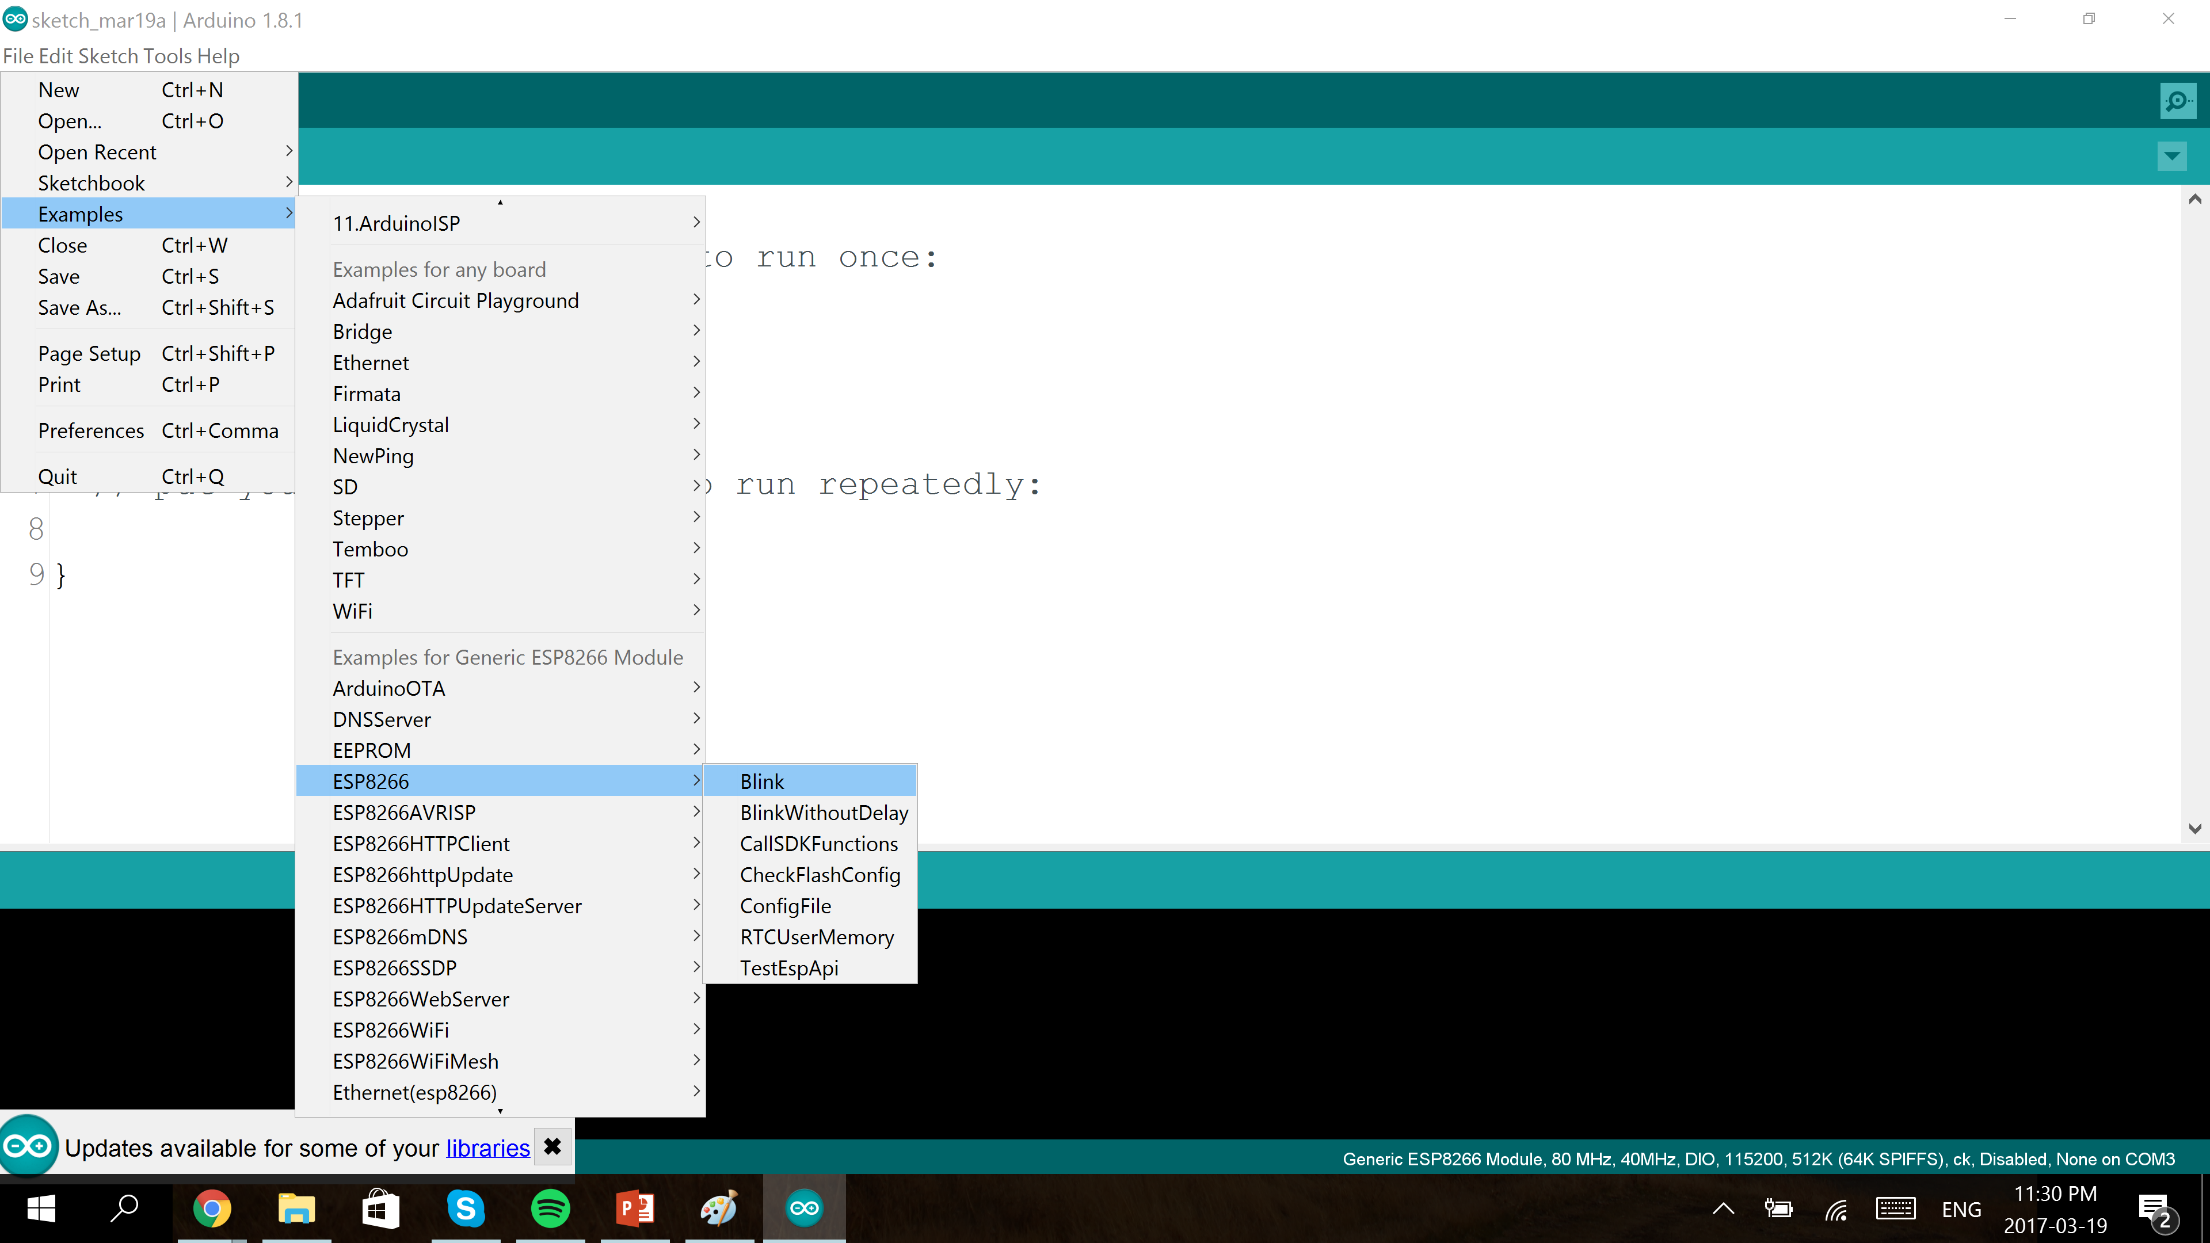
6. Go to example, esp8266, blink

Slide 13
7.Upload the code

Slide 14
7. Unplug the Arduino from computer
8. Unplug GPIO0 from GND
9. plug the Arduino to computer
10. The blue light on ESP8266 should be blinking now

